Slide 1
Working Session
GES 4070 / 5070: Geovisualization – Fall 2026
Fuzhen Yin
GES – UCCS

Slide 2
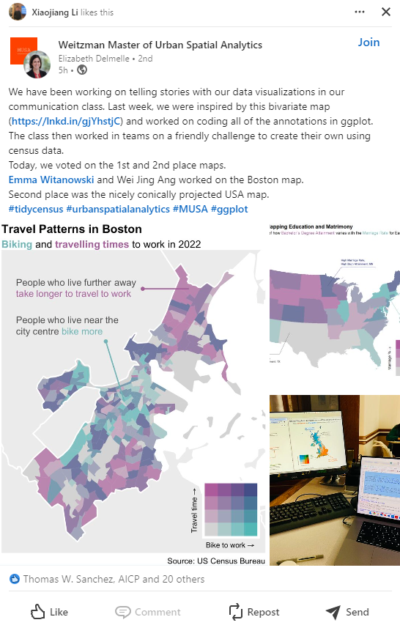
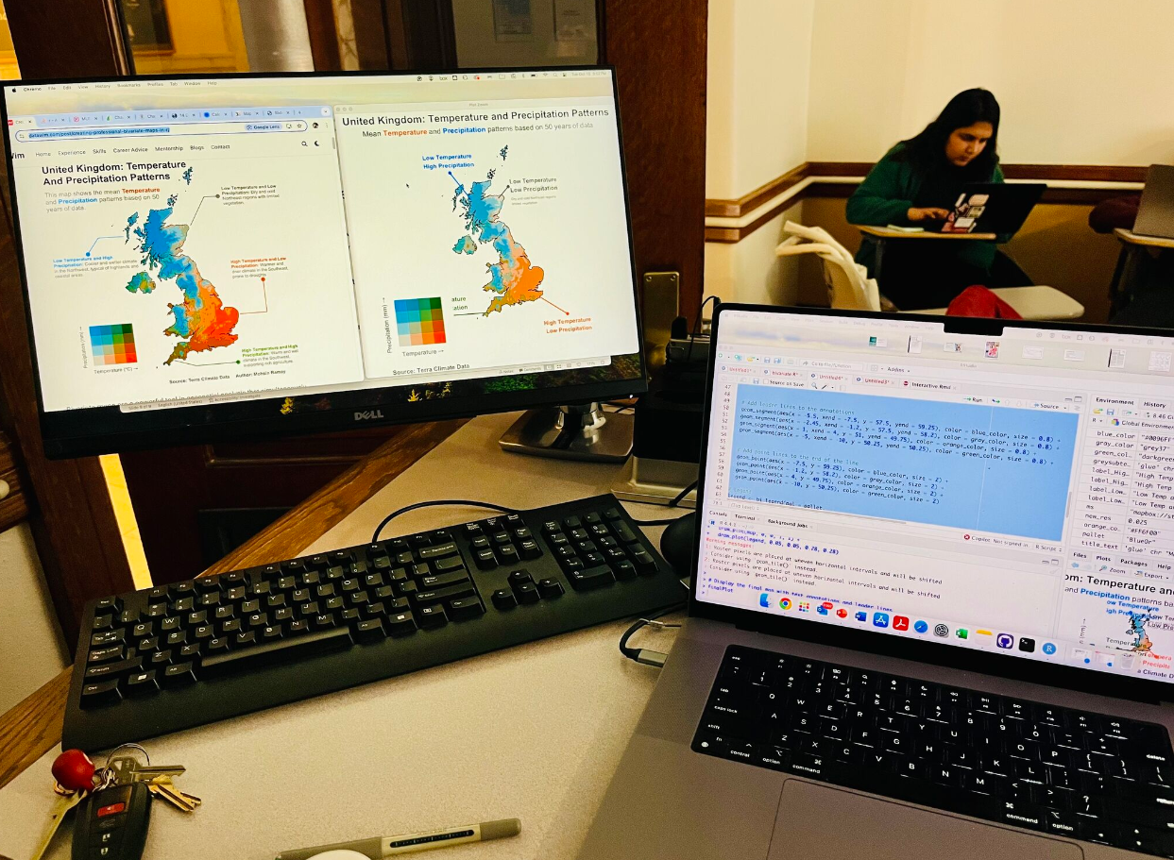
Daily Dose of Internet
Credit to Elizabeth Delmelle (LinkedIn Post)

Slide 3
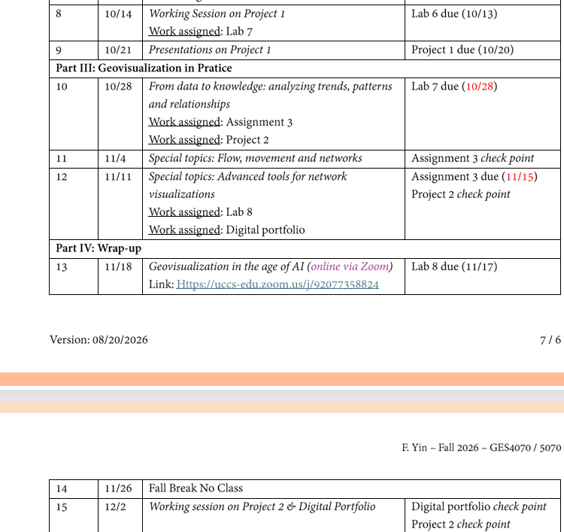
Announcement

Slide 4
Poster Due Next Week (10/20)
Lab 6/7 Due the Week After (10/27)
You will have two weeks to work on Lab 7.

Slide 5
Where are we?
Geo-visualization
Lecture 1: What is Geo-visualization
Lecture 2: Data Abstraction
Lecture 3: Data Analysis & Visualization Workflow
Lecture 4: Intro to Spatial Visualization – Map Making
Lecture 5: Intro to Spatial Visualization (2) Spatial Data Manipulation
Lecture 6: Spatial Data Manipulation, Advanced Mapping, & Debugging
Lecture 7: Data Structure, Debugging & Coding Practices Recap
Lecture 8: Identifying Point Patterns; Working Sessions for Poster Presentation
Non-spatial data
Spatial data
Network data

Slide 6
Poster Presentation Preparation

Slide 7
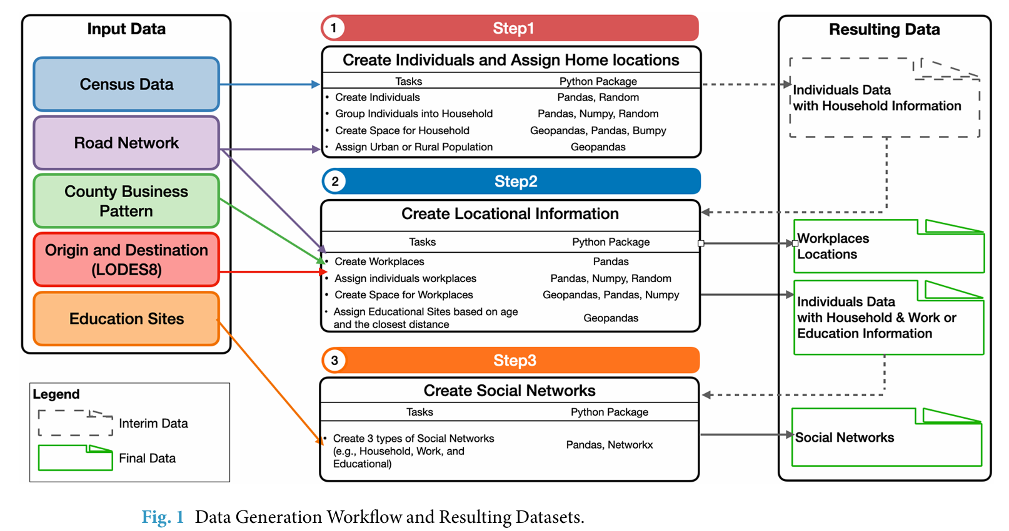
Workflow Diagram

Slide 8
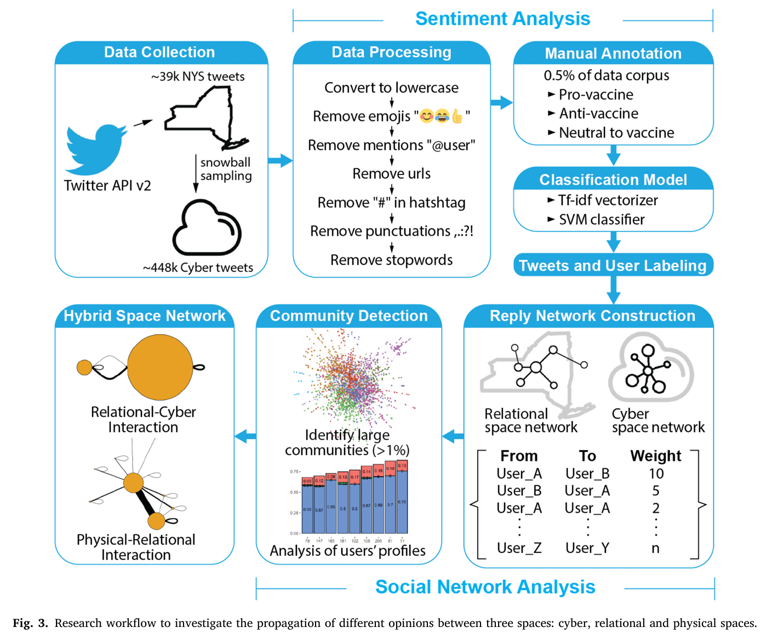
Workflow Diagram

Slide 9
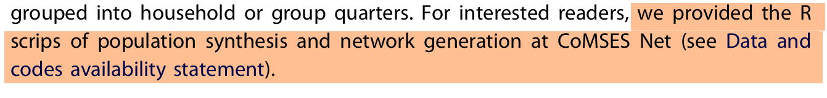
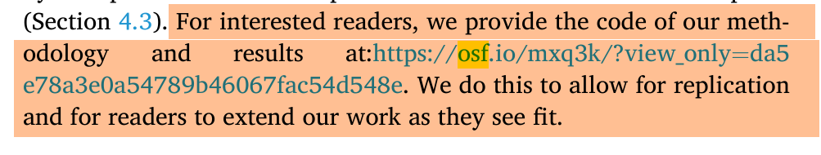
Promote FAIR research by sharing your workflow!
Findable,
Accessible,
Interoperable, and
Reusable
Create an online repository of your project to share your Data and Script, e.g., on GitHub or OSF
Get a publicly accessible url, save this url (later you can put it to your portfolio).
Use online QR Code Generator to create a QR code for the url

Slide 10
How to print posters in GIS Lab 331?
Poster template (.pptx) is available on Canvas
  Assignment “Project 1”
  “GES4070_5070_Project 1_pptx_poster_template_36x36”
Upon completion, export it as .pdf.

Slide 11
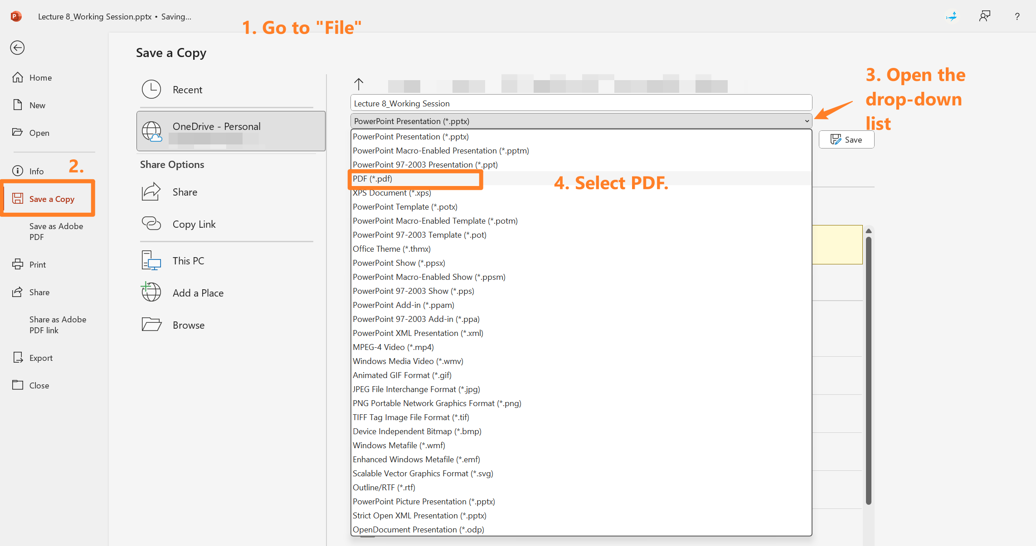

Slide 12
How to print posters in GIS Lab 331?
Poster template (.pptx) is available on Canvas
  Assignment “Project 1”
  “GES4070_5070_Project 1_pptx_poster_template_36x36”
Upon completion, export it as .pdf.
Use a USB to transfer the saved .pdf to the printer.
Insert USB --> Select file --> print
Print early. Don’t wait until the last minutes.

Slide 13
Presentation
Presentation starts at 9:30
Students will be divided into two groups, A and B, each has 12 people.
9:30 – 10:30, Group A presents, Group B observes
10:40 – 11:40, Group B presents, Group A observes
Inspired by Dr. Dao’s advanced GIS class.
Notes:
180/2 = 90. 90 / 12 =

Slide 14

Presentation
E.g., when Group A presents
Students in the Group A stand in front of their posters
Students in Group B can walk around, ask questions.

Slide 15
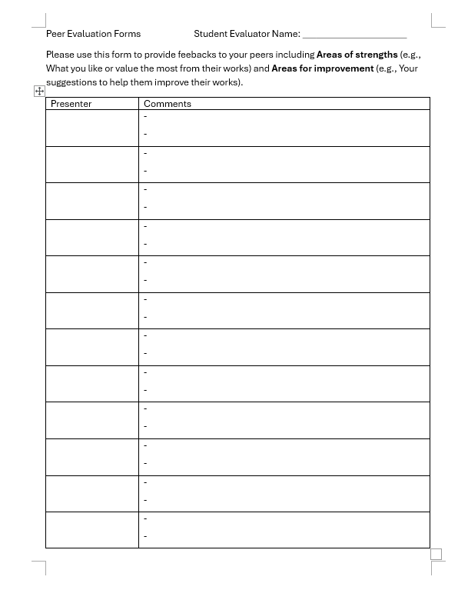
Presentation
The instructor will provide a ‘Peer Evaluation Form’ next week.
When it’s your term to observe, please talk to all the presenters and complete the form.

Slide 16
Let’s deciding on groups!
Please fill out your presentation title in the shared google doc by this Friday (the 16th) so I can send the invitation.
https://docs.google.com/document/d/1DSk83T9F2wB-sd9ALq4Eq1ykjjFRDSda1qxGFOjcOl8/edit?usp=sharing

Slide 17
Lab 7

